Slide 1
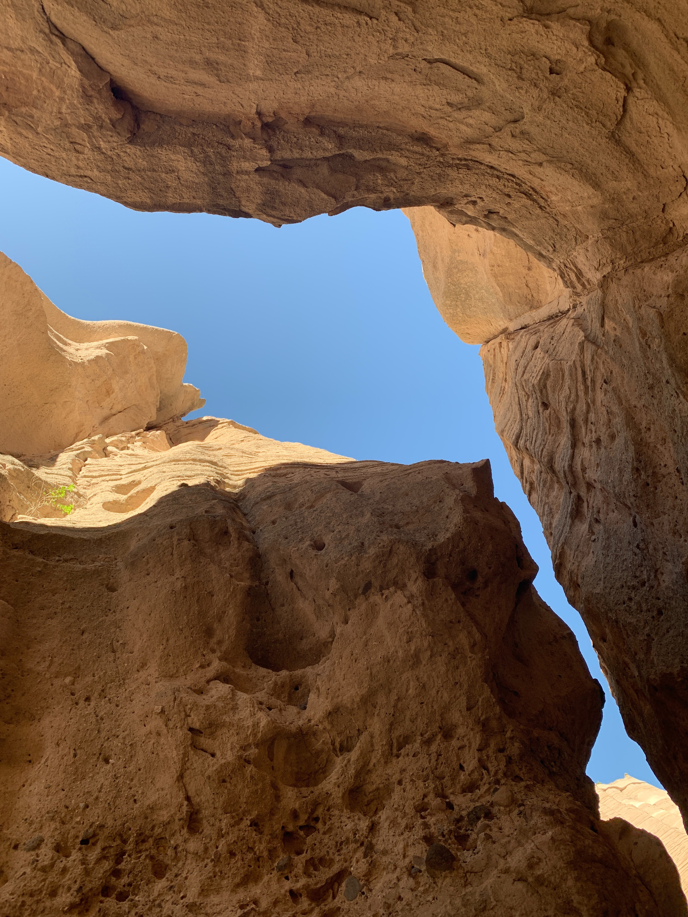



dhsem.nm.gov
NEW MEXICO HOME RECOVERY PROGRAM: Chaves County Community Town Hall
September 2026
New Mexico Department of Homeland Security & Emergency Management

Slide 2
PROGRAM OVERVIEW
The New Mexico Home Recovery Program is funded through the Community Development Block Grant for Disaster Recovery (CDBG-DR).
The State of New Mexico received $137M in CDBG-DR funding.
Funds are allocated by U.S. Department of Housing and Urban Development (HUD).
All funding must be used to recover from disasters which were federally declared in 2024 (DR-4795 or DR-4843).
New Mexico Department of Homeland Security & Emergency Management

Slide 3
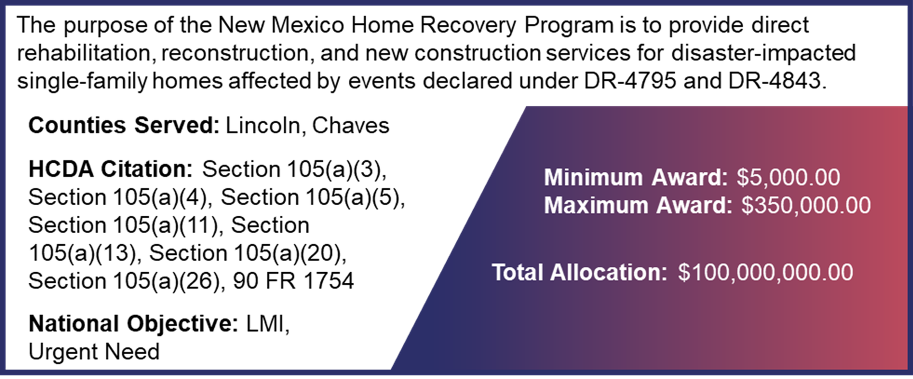
PROGRAM OVERVIEW (cont.)
New Mexico Department of Homeland Security & Emergency Management

Slide 4
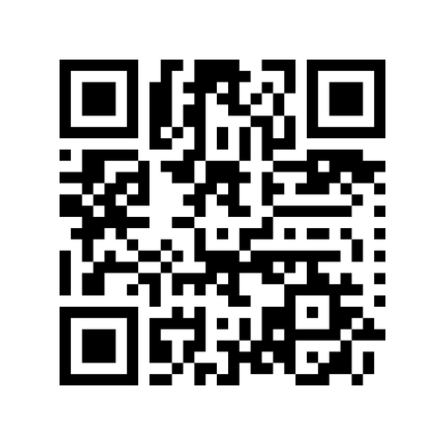
ONLINE RESOURCES
Access New Mexico Home Recovery Program information on DHSEM’s CDBG-DR website at www.dhsem.nm.gov/cdbg-dr2025
  New Mexico Home Recovery Program Application
  Disaster Case Management Information
  Program Guide and Policies
  Updates and Information
New Mexico Department of Homeland Security & Emergency Management

Slide 5
APPLICATIONS RECEIVED
Intent to Apply | Applications Submitted | Completed Applications
626 | 128 | 63
Data as of: September 11, 2026, 8:00 AM
New Mexico Department of Homeland Security & Emergency Management

Slide 6

HOW TO
APPLY
DHSEM is now accepting applications!
Online at www.dhsem.nm.gov/cdbg-dr2025, through Disaster Case Management, 505-670-4662 or DHSEM-DCM@dhsem.nm.gov
Applications will not be processed until all documentation is received.
The application will stay open until all program funds have been spent. There is no official close date for this application at this time.
New Mexico Department of Homeland Security & Emergency Management

Slide 7
DISASTER CASE MANAGEMENT
Disaster Case Managers can help you complete an application and collect documents.
Schedule a site visit with a case manager.
Phone: 505-670-4662
Email: DHSEM-DCM@dhsem.nm.gov
More information and future workshop dates are also available at www.dhsem.nm.gov/cdbg-dr2025.
New Mexico Department of Homeland Security & Emergency Management

Slide 8
ROSWELL
WORKSHOPS
Thursday, September 24
8 a.m. to 4:30 p.m.
ENMU Roswell
48 University Boulevard
CUB Multi-Purpose Room 110
Tuesday, September 29
10 a.m. to 4:30 p.m.
Roswell Public Library
301 N. Pennsylvania Ave.
View workshop schedule online at www.dhsem.nm.gov/cdbg-dr2025/homerecovery.
New Mexico Department of Homeland Security & Emergency Management

Slide 9
PROGRAM ELIGIBILITY
  Disaster Impact
    Home must have sustained and have unrepaired damage directly related to either DR-4795 or DR-4843
  Primary Residence
    Applicant must be seeking assistance for their primary residence.
    No vacation homes, investment properties, rental properties, etc.
  Geographic Location
    Home must be located in either Chaves County or Lincoln County.
  Income Limit
    Household income must be at or below 120% of Area Median Income (AMI)
New Mexico Department of Homeland Security & Emergency Management

Slide 10
INCOME LIMITS
Chaves County
Number of Persons in Family
FY2026 Income Limit Category | 1 | 2 | 3 | 4 | 5 | 6 | 7 | 8
Extremely Low (30%) | $15,300 | $17,500 | $19,700 | $21,850 | $23,600 | $25,350 | $27,100 | $28,850
Very Low (50%) | $25,550 | $29,200 | $32,850 | $36,450 | $39,400 | $42,300 | $45,200 | $48,150
Low (80%) | $40,850 | $46,650 | $52,500 | $58,300 | $63,000 | $67,650 | $72,300 | $77,000
Eligible (120%) | $61,250 | $70,000 | $78,750 | $87,500 | $94,500 | $101,500 | $108,500 | $115,450
New Mexico Department of Homeland Security & Emergency Management

Slide 11
OWNERSHIP REQUIREMENTS
  Property Taxes
    The applicant must be current on their property taxes or have a property tax payment plan in good standing.
  Mortgage Payments
    If there is a mortgage on the property, the mortgage must be in good standing.
  Manufactured Housing Unit Owners
    Manufactured housing unit owners must be in good standing with regards to rent or lease payments on that property at the time of application and for the duration of the program.
New Mexico Department of Homeland Security & Emergency Management

Slide 12
DOCUMENTATION
Completed Application
Valid Photo ID
Income Documentation
Home Ownership Documentation
Primary Residence Documentation
Insurance Documentation
Proof of Disaster Damage
Disability Documentation
(if applicable)
New Mexico Department of Homeland Security & Emergency Management

Slide 13
DOCUMENTATION
USE PURPOSE
What does the New Mexico Home Recovery Program do with this documentation?
Verify program eligibility
Conduct duplication of benefit checks
Reduce the risk that funds may be recouped in the future
New Mexico Department of Homeland Security & Emergency Management

Slide 14
APPLICATION PRIORITIZATION
Applications will be prioritized based on:
  Household income
    Income categories: Extremely Low (<30% AMI), Very Low (30-50% AMI), Low (50-80% AMI), and Moderate (80-120% AMI)
  Vulnerability factors
    Household members who have disabilities (as defined by the ADA)
    Households with elderly members (65 and older)
    Households whose homes were severely damaged
If all prioritization factors are the same, applications will be processed on a first come, first served basis.
New Mexico Department of Homeland Security & Emergency Management

Slide 15
NEXT STEPS AFTER YOU APPLY
Eligibility
Assessment
Environmental Review
Award Determination
Work Begins
The program will review your application and make an eligibility determination.
A Disaster Case Manager may request additional documents as needed.
A property assessor will visit your property, take photos, assess the disaster
damage and estimate the cost of repairs.
The program will check environmental conditions at your property
(e.g. if it is in a floodplain, historic landmark).
You will receive an award determination letter that tells you what assistance you can receive.
You can accept, deny, or appeal.
If you accept, DHSEM will assign a contractor,
conduct a site visit and begin work.
New Mexico Department of Homeland Security & Emergency Management

Slide 16

PROGRAM TIMELINE
February 2026
June
2026
July &
August
2026
September
2026
October
2026
October
2026
Application period opened
Environmental
Review Tier 1 Complete
DHSEM Selects Vendors to Support HRP Activities
Environmental Review Tier 2s Begin
Property Assessments Begin
Construction Begins
New Mexico Department of Homeland Security & Emergency Management

Slide 17
dhsem.nm.gov
Questions?
New Mexico Department of Homeland Security & Emergency Management

Slide 18
dhsem.nm.gov
Contact Information:
For questions about the application or to receive free assistance, please contact:
Disaster Case Management Team
505-670-4662
DHSEM-DCM@dhsem.nm.gov
Andrew Kloefkorn
CDBG-DR Bureau Chief
505-623-5178
andrew.kloefkorn@dhsem.nm.gov
Andrea Niehaus
Deputy Project Manager
319-759-1195
andrea.niehaus@dhsem.nm.gov
New Mexico Department of Homeland Security & Emergency Management

