Slide 1

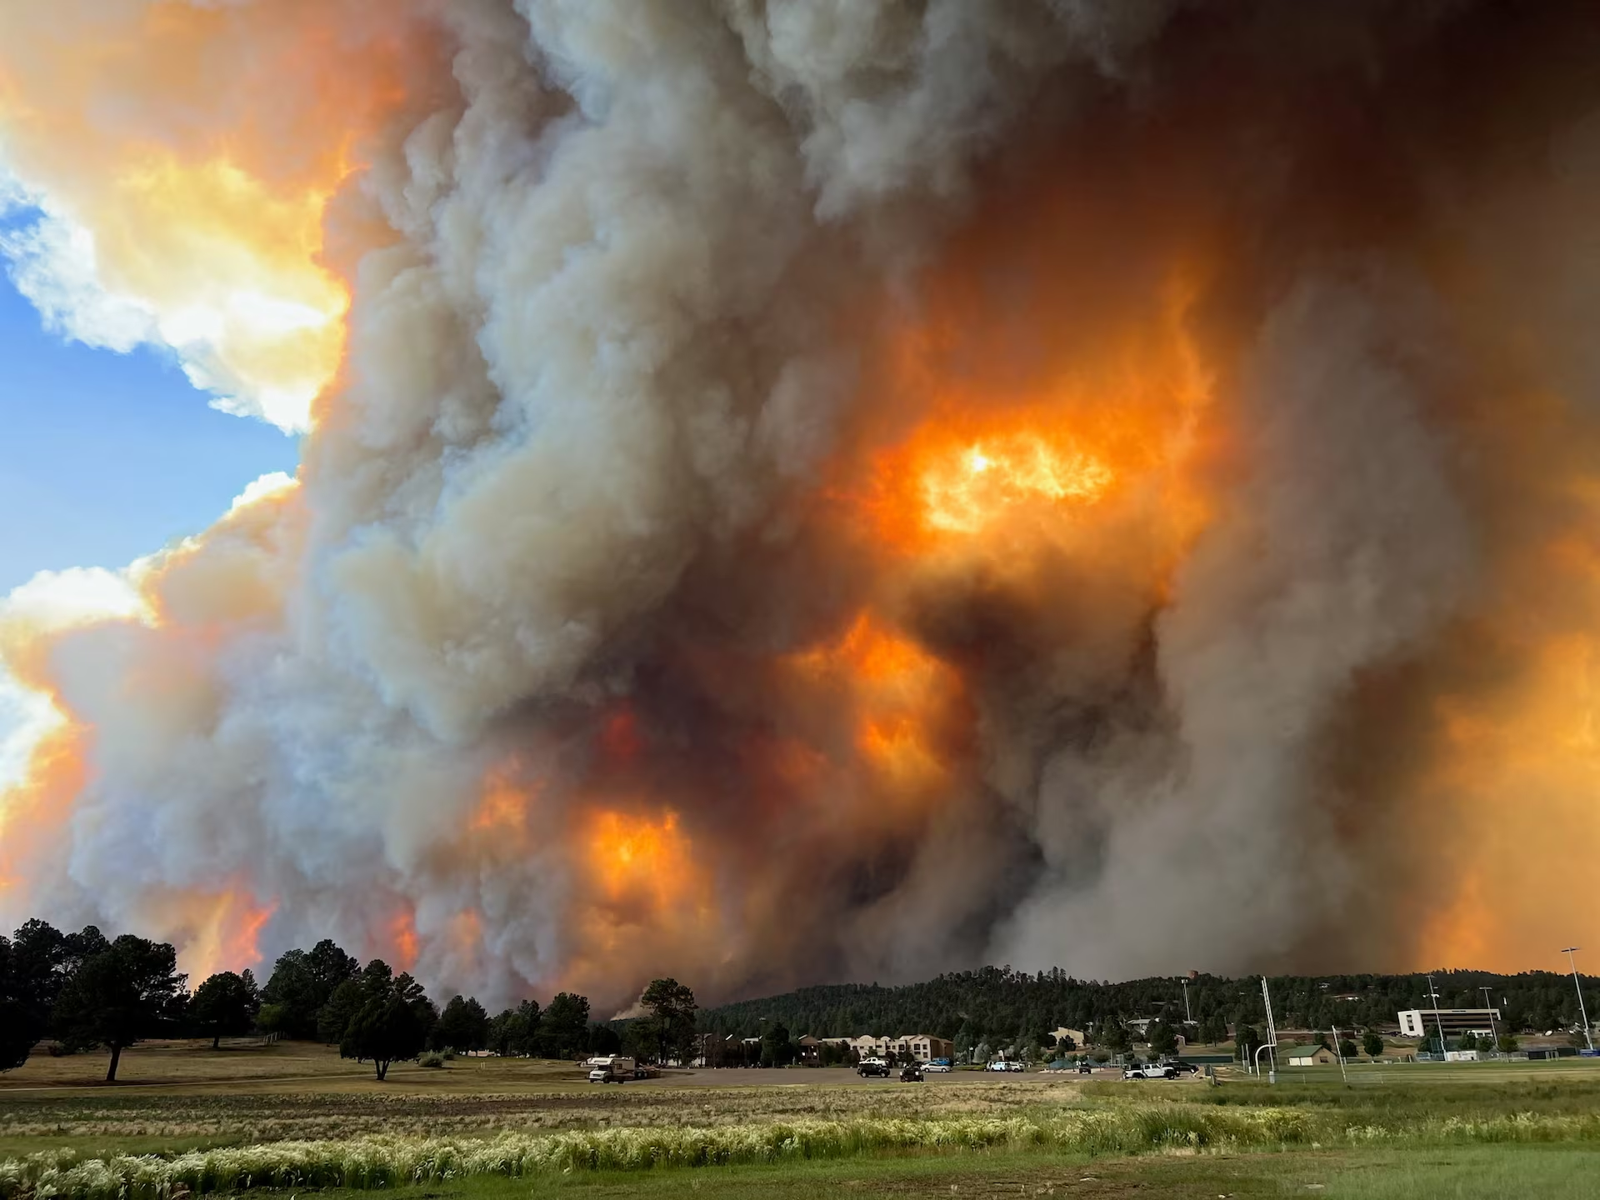
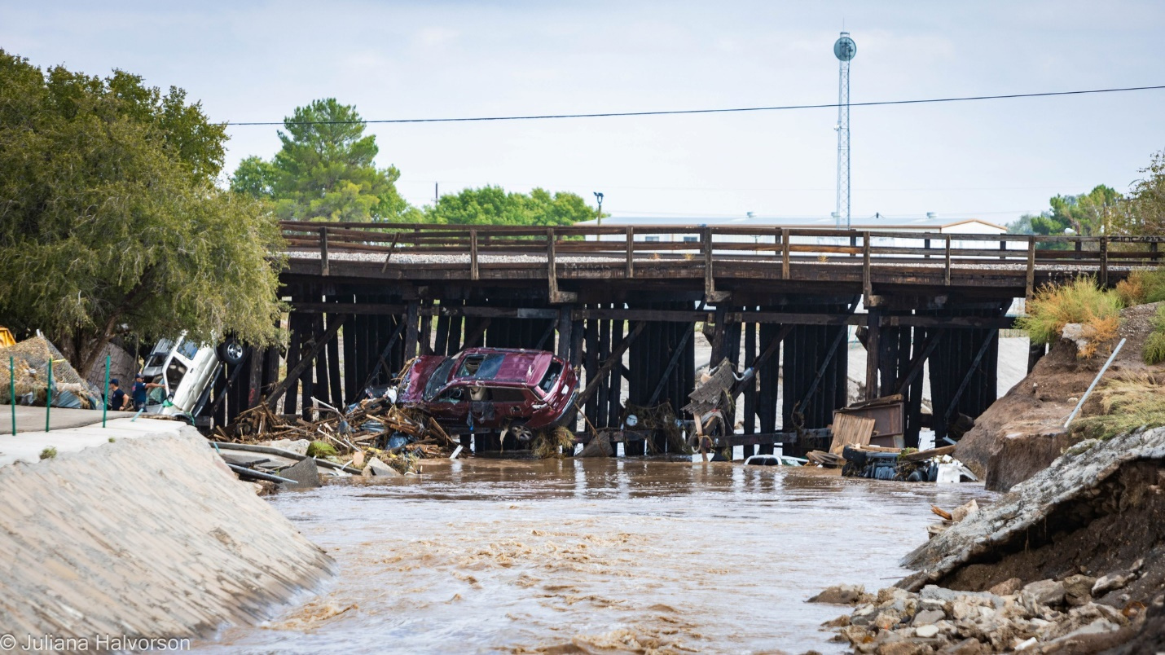

dhsem.nm.gov
Community Development Block Grant – Disaster Recovery
Recovery Funding for Your Community’s Unmet Needs
New Mexico Department of Homeland Security & Emergency Management

Slide 2

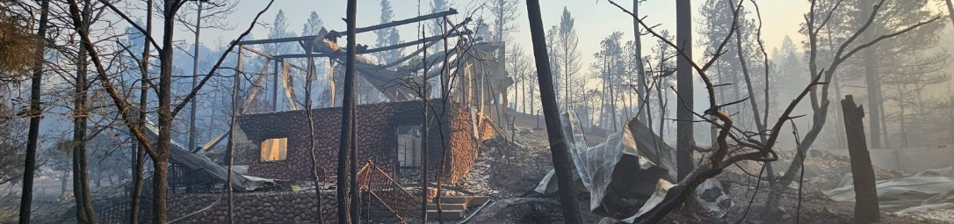
What is CDBG-DR?
These funds are here to to fill in the gaps in recovery.
The State of New Mexico received
$137M in CDBG-DR funding.
Funds are allocated by U.S. Dept. of Housing and Urban Development.
All funding must be used to recover from disasters which were federally declared in 2024.
New Mexico Department of Homeland Security & Emergency Management

Slide 3
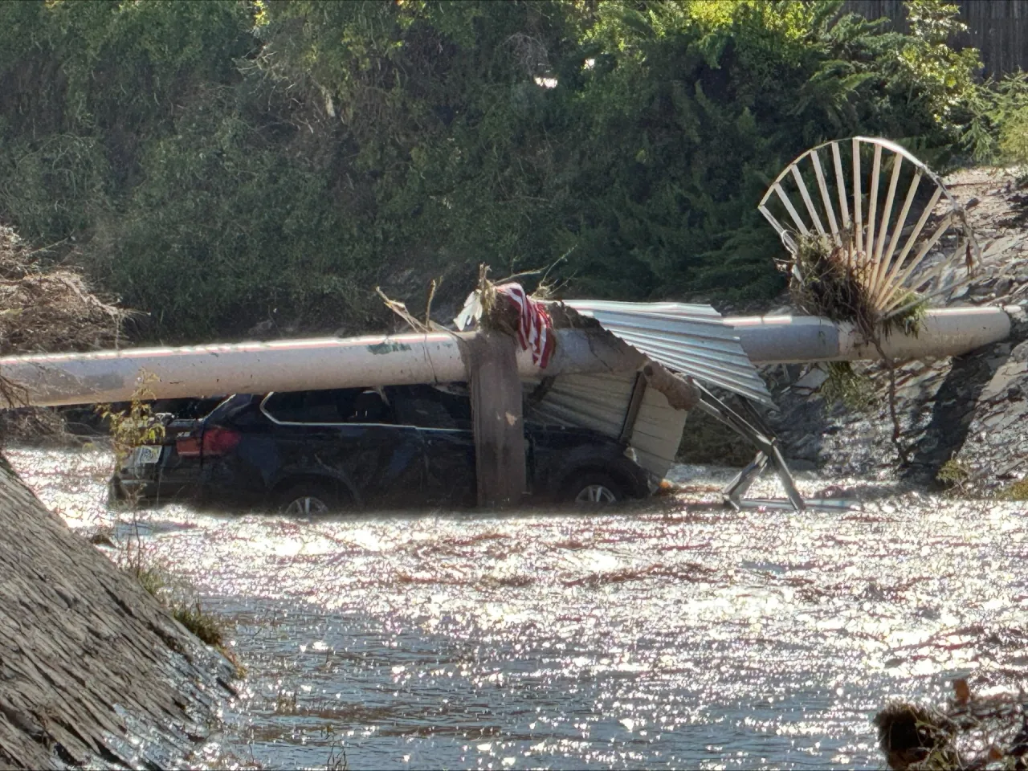
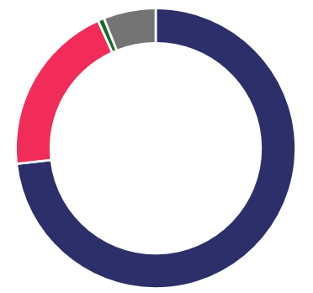
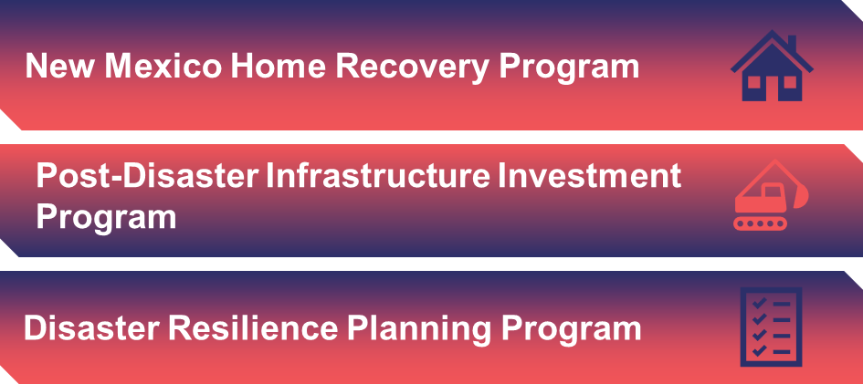
Method of Distribution
New Mexico Department of Homeland Security & Emergency Management

Slide 4
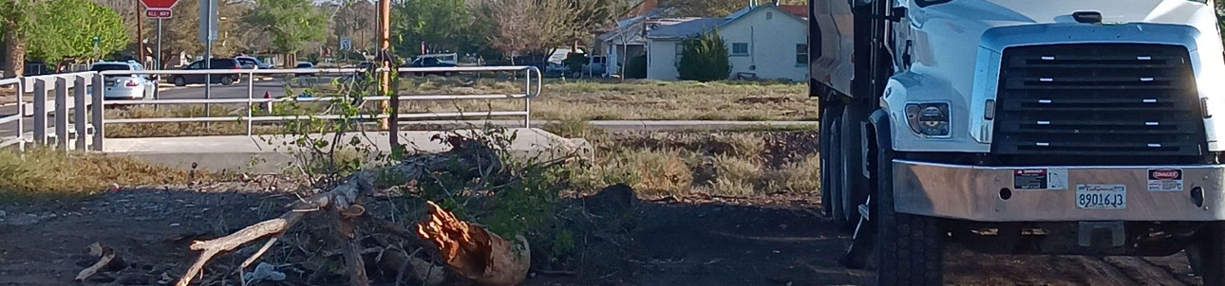
Required Spending Targets
70%
80%
spent on low- to moderate-income persons.
spent on most impacted and distressed areas.
New Mexico Department of Homeland Security & Emergency Management

Slide 5
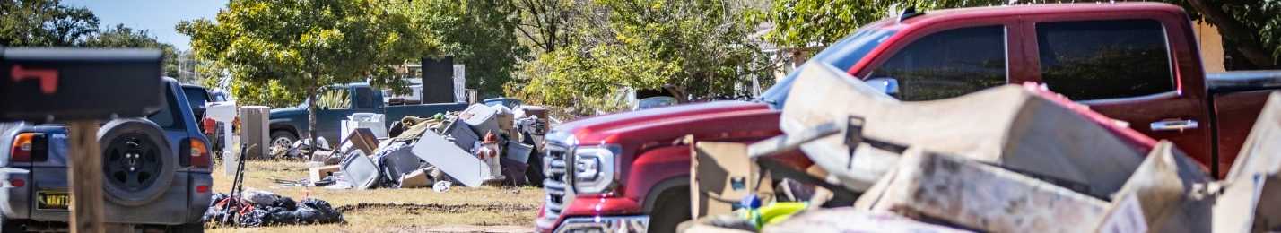
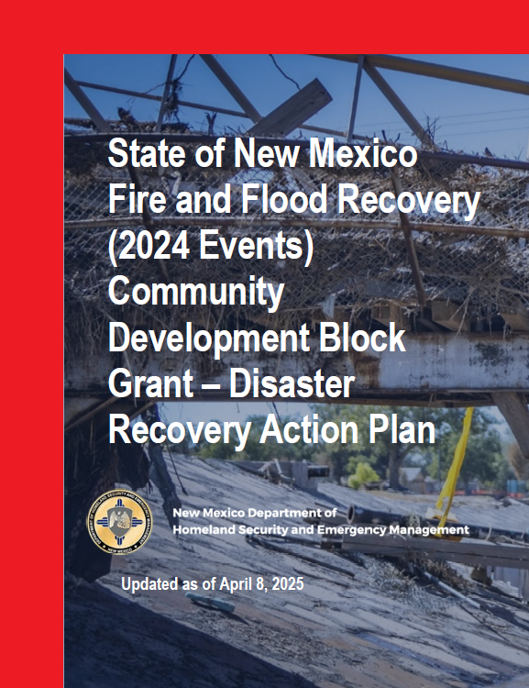

Public Action Plan
Unmet Needs Assessment
Method of Distribution
Compliance Requirements
New Mexico Department of Homeland Security & Emergency Management

Slide 6
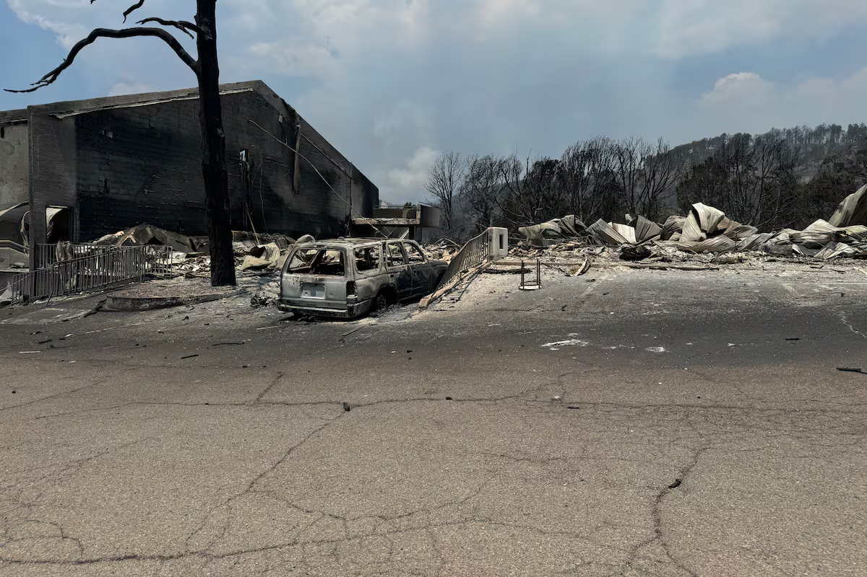




CDBG-DR Needs Formula
HUD’s formula identifies levels of need using FEMA data. Unmet needs are based on these levels of need, minus the assistance provided through programs like Individual Assistance, Public Assistance, and Small Business Administration Loans. Needs are assessed in four main categories:
Housing
Economy
Infrastructure
Planning
$102M
$61M
$153M
$12M

Slide 7
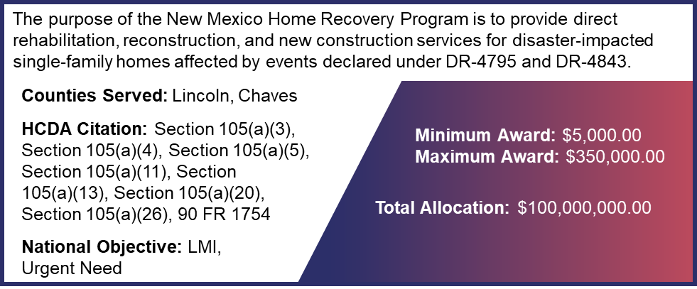
Housing Recovery Program
New Mexico Department of Homeland Security & Emergency Management

Slide 8
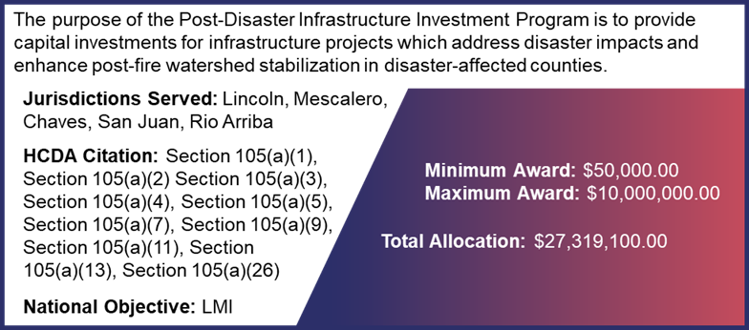
Infrastructure Investment
New Mexico Department of Homeland Security & Emergency Management

Slide 9
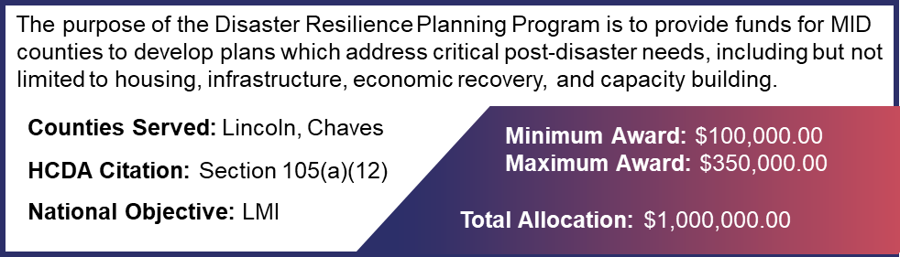
Resilience Planning
New Mexico Department of Homeland Security & Emergency Management

Slide 10

Programs for Recovery
New Mexico Home Recovery Program
Post-Disaster Infrastructure Investment Program
Disaster Resilience Planning Program
Provide full home repair, reconstruction, or new construction for disaster-impacted households.
Repair/rehabilitation is eligible if the cost is less than 60% of the pre-disaster home value
Includes assistance for mitigation, such as elevating units above base flood elevation.
Provides grant funding to support the completion of infrastructure projects.
Must serve low- to moderate-income populations (area benefit).
Must follow HUD requirements (e.g., Davis Bacon).
Provides grant funding to support development of community recovery and resilience plans.
Local governments, non-profits and universities are eligible to apply.
New Mexico Department of Homeland Security & Emergency Management

Slide 11
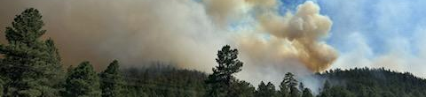
Funding Summary
Category | Percent of Allocation | Program Allocation | Target Spend on HUD-Identified MID
Administration | 5% | $6,858,900.00 | N/A
State Planning Costs | 1% | $2,000,000.00 | N/A
New Mexico Home Recovery Program | 73% | $100,000,000.00 | $100,000,000.00
Post-Disaster Infrastructure Investment Program | 20% | $27,319,100.00 | $13,659,550.00
Disaster Resilience Planning Program | 1% | $1,000,000.00 | $1,000,000.00
Total |  | $137,178,000.00 | $114,659,550.00
New Mexico Department of Homeland Security & Emergency Management

Slide 12
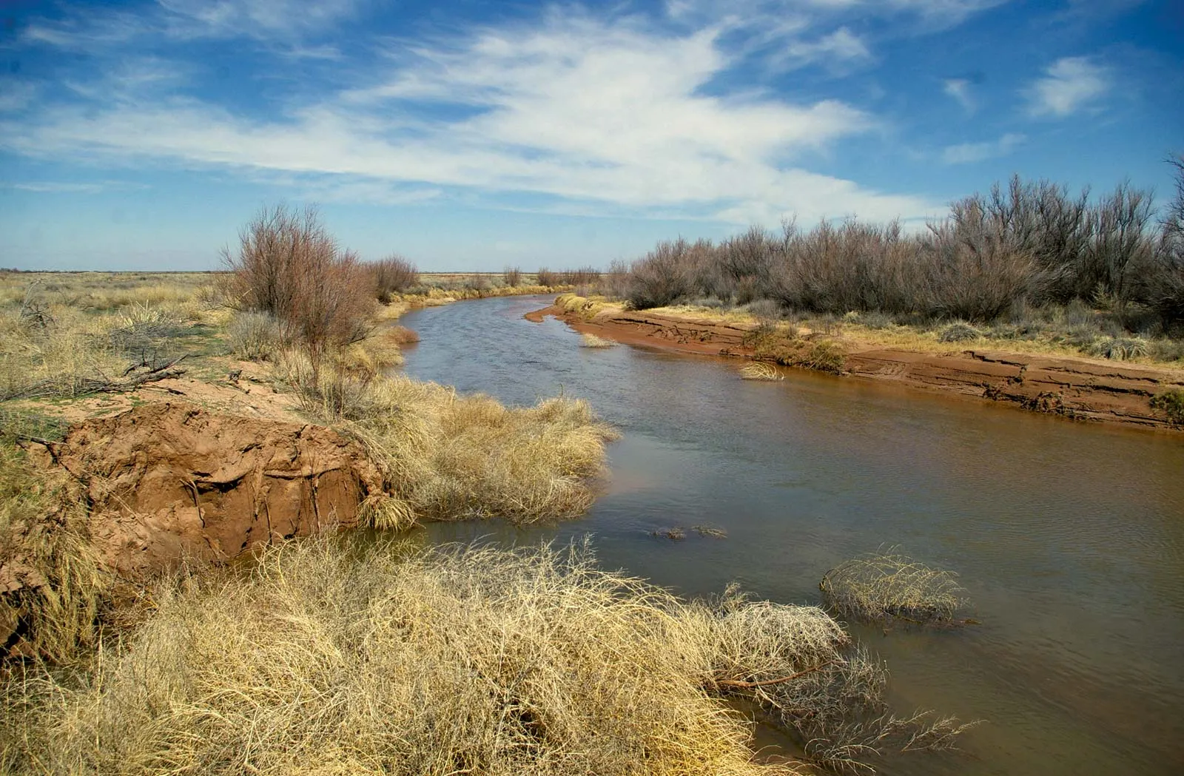
Public Comment
We are currently in an open 30-day public comment period.
Agency partners are welcomed to comment or notify residents.
Written Comments
Oral Comments
Email: publiccomments@dhsem.nm.gov
Action Plan Website: Click on the “Submit Your Comment” blue box
https://www.dhsem.nm.gov/
Mail: Public Comments, 3005 S St Francis Dr, STE 1-D, #404, Santa Fe, NM 87505
Provide verbal comments to a Disaster Case Manager
Call the Disaster Case Management helpline at 505-670-4662
Attend any state-sponsored recovery event and speak with a DHSEM team member
New Mexico Department of Homeland Security & Emergency Management

Slide 13
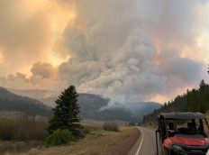
CDBG-DR Public Comment
Thank you for your time and participation!
New Mexico Department of Homeland Security & Emergency Management

