Slide 1
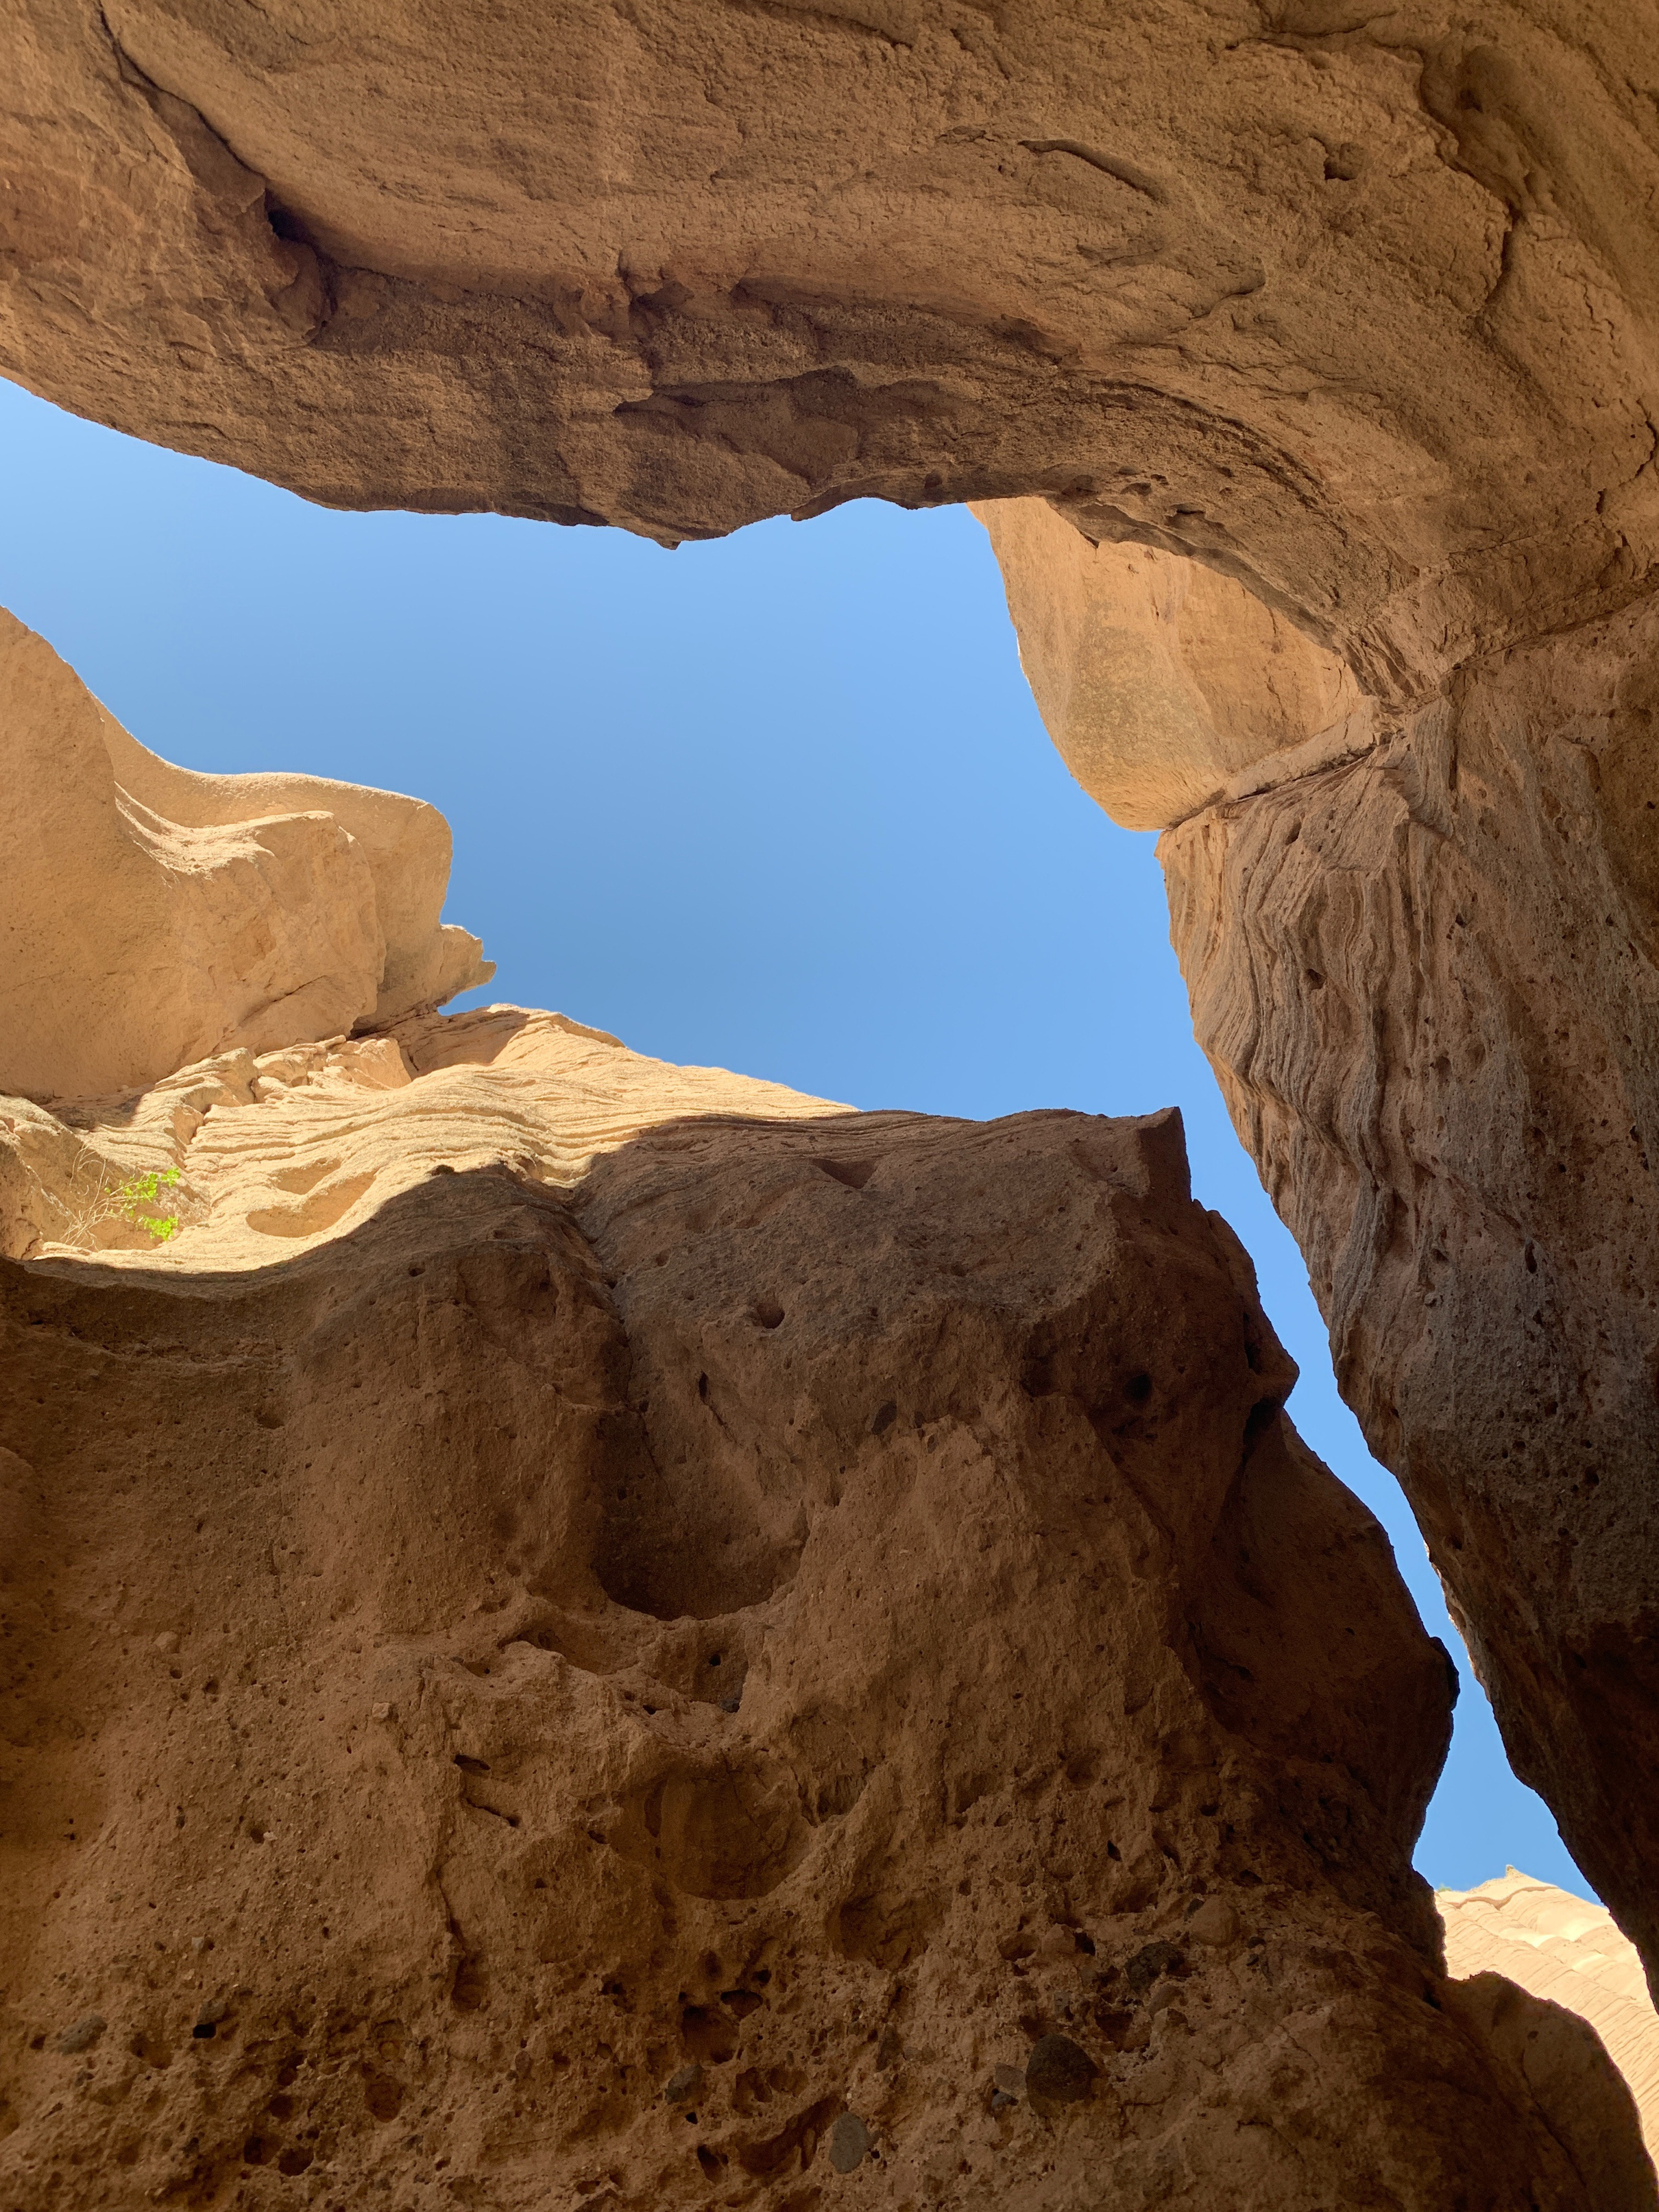



dhsem.nm.gov
POST-DISASTER INFRASTRUCTURE INVESTMENT PROGRAM
DHSEM | Community Development Block Grant - Disaster Recovery (CDBG-DR)
New Mexico Department of Homeland Security & Emergency Management

Slide 2
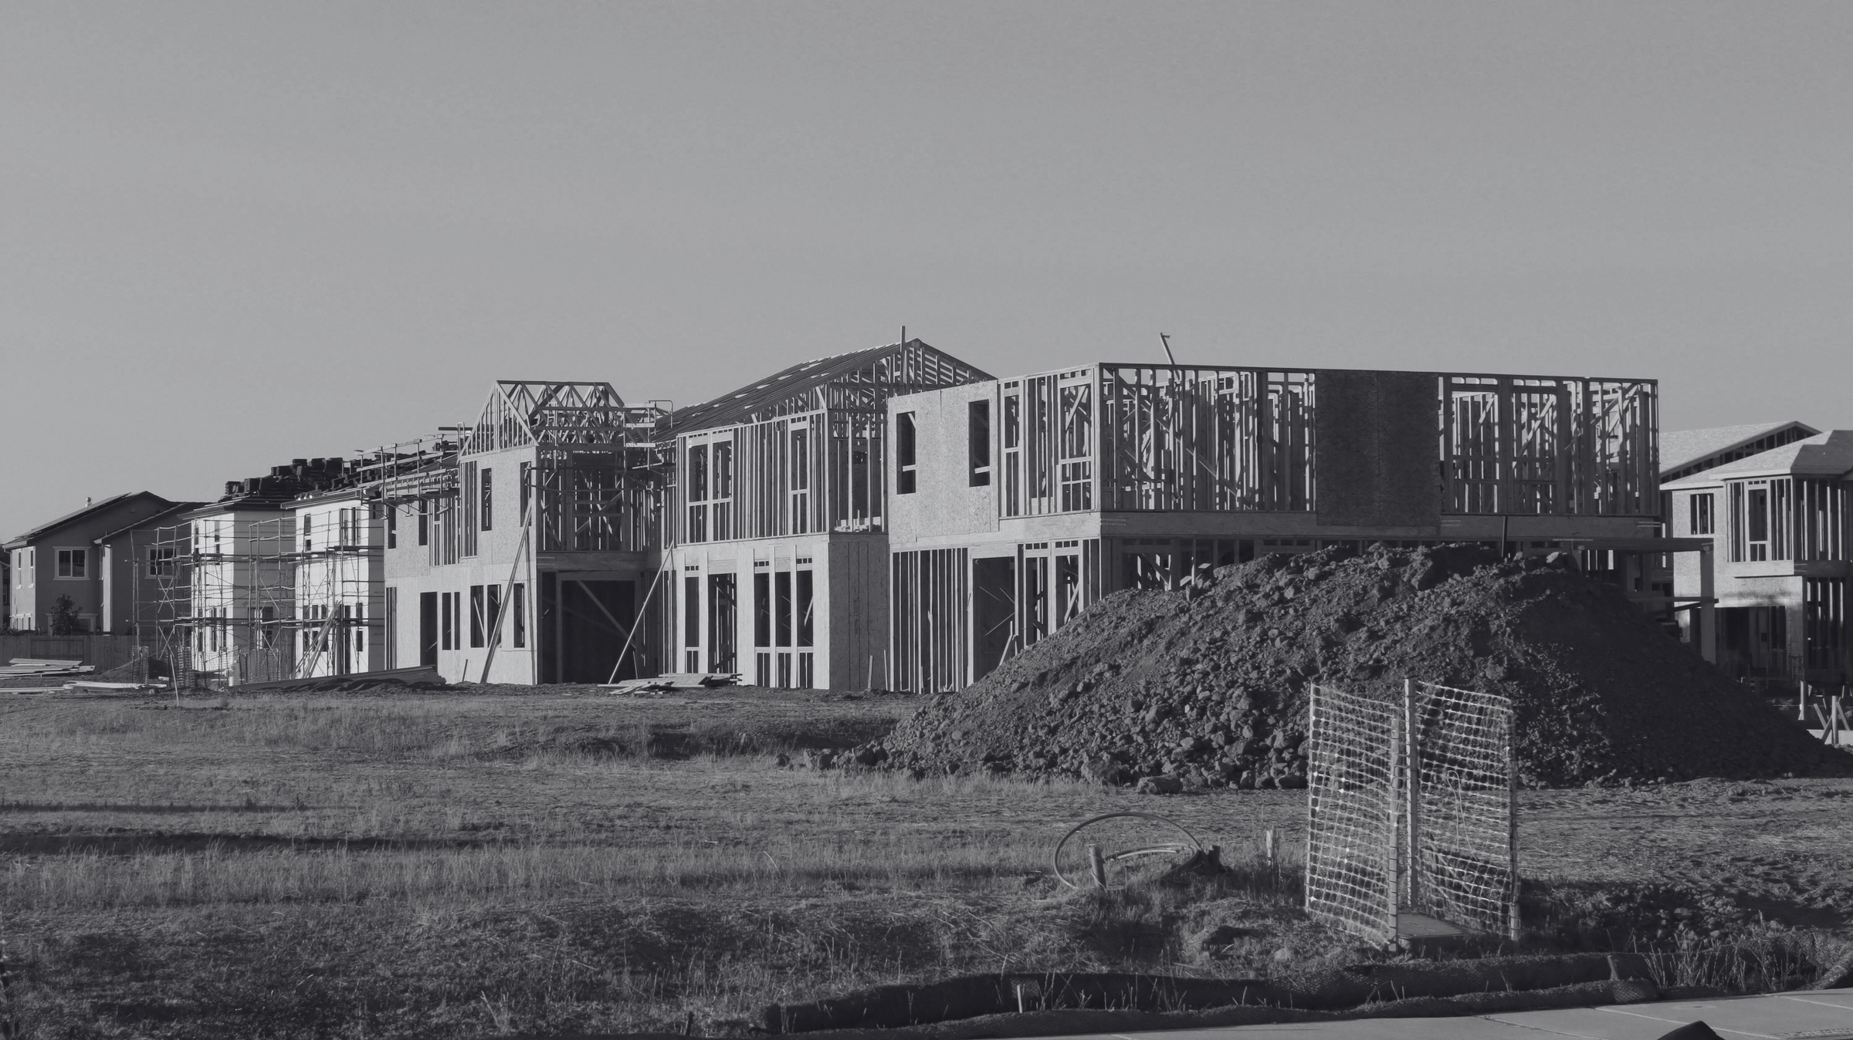
Post Disaster Infrastructure Investment (PDIIP)
Welcome!
The purpose of today’s meeting:
  Provide information to eligible entities on the PDIIP
  Review the Notice of Funding Availability (NOFA) timeline
  Review eligible activities
  Review proposal requirements
  Answer questions
New Mexico Department of Homeland Security & Emergency Management

Slide 3
What is CDBG-DR?
CDBG-DR = Community Development Block Grant for Disaster Recovery
The State of New Mexico received $137M in CDBG-DR funding.
Funds are allocated by U.S. Department of Housing and Urban Development (HUD).
All funding must be used to recover from disasters which were federally declared in 2024 (DR-4795 or DR-4843).
New Mexico Department of Homeland Security & Emergency Management
New Mexico Department of Homeland Security & Emergency Management

Slide 4
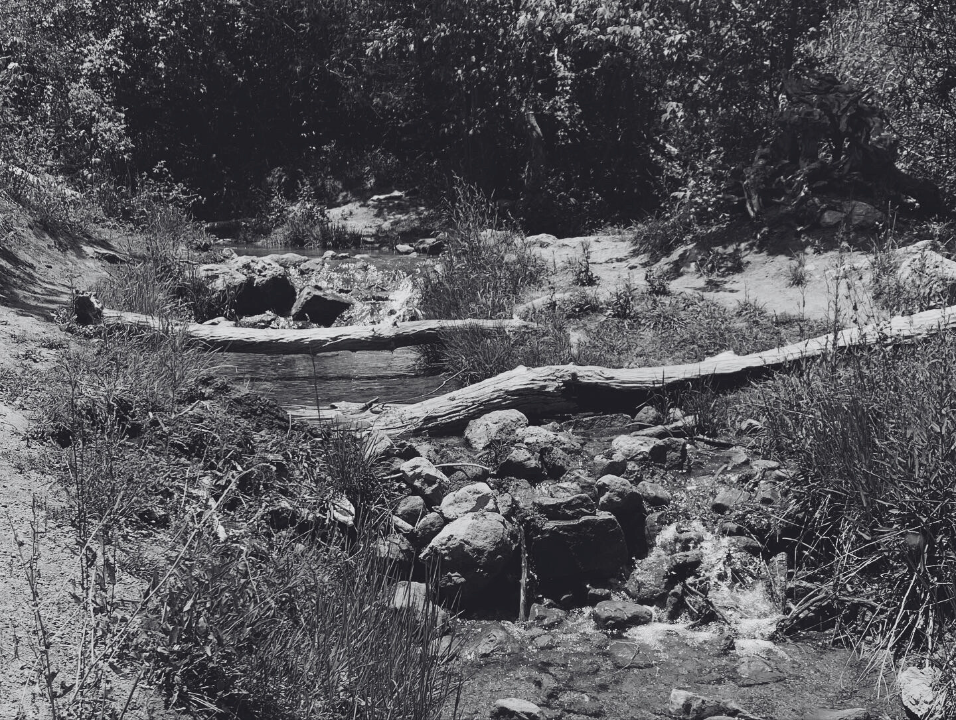
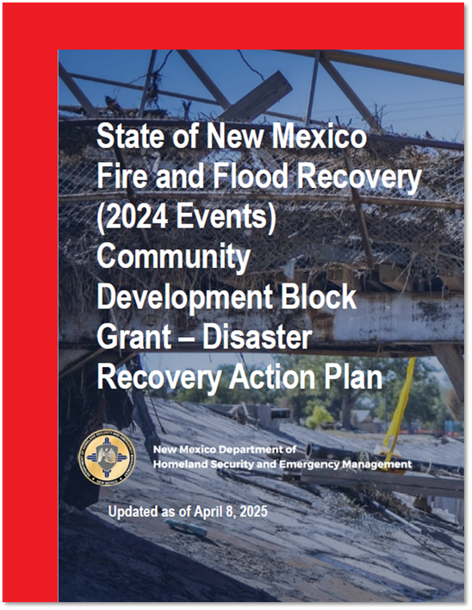
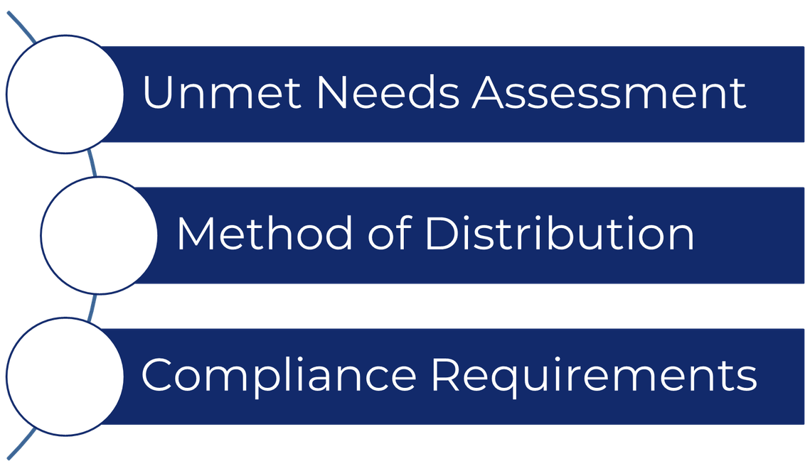
Action Plan
The Action Plan is pubicly available at dhsem.nm.gov/cdbg-dr2025
New Mexico Department of Homeland Security & Emergency Management

Slide 5
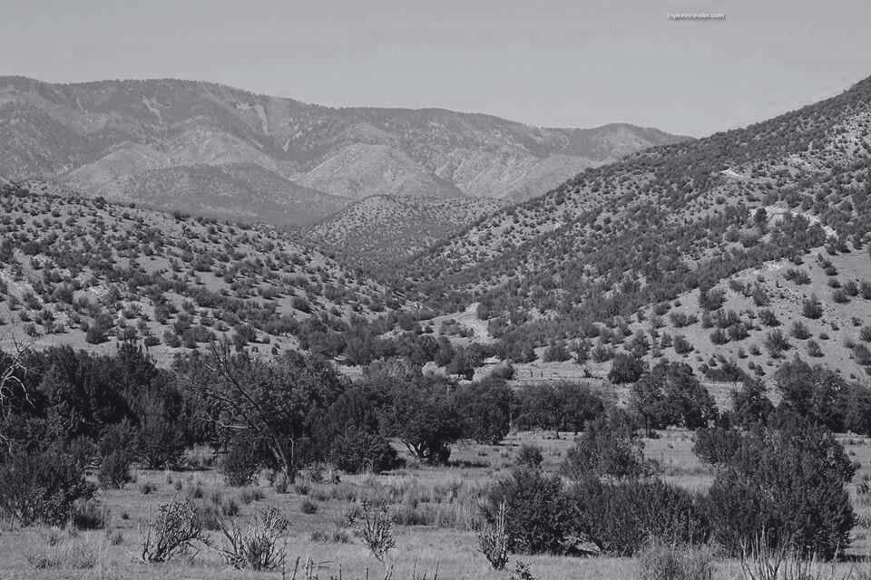
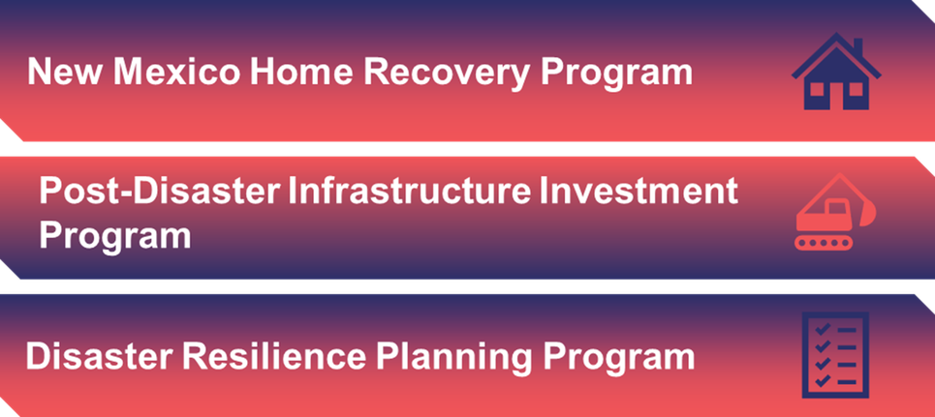
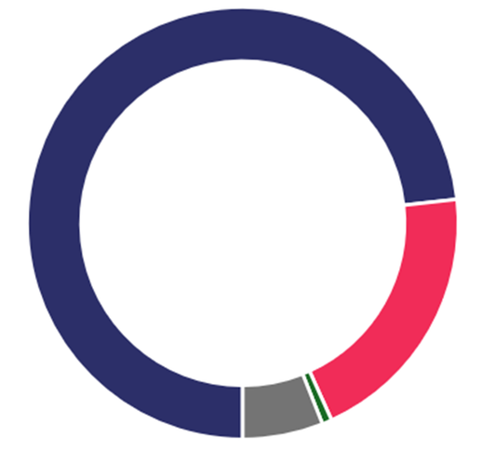
CDBG-DR Funding Method of Distribution
$100,000,000.00
$27,319,100.00
$1,000,000.00
New Mexico Department of Homeland Security & Emergency Management

Slide 6
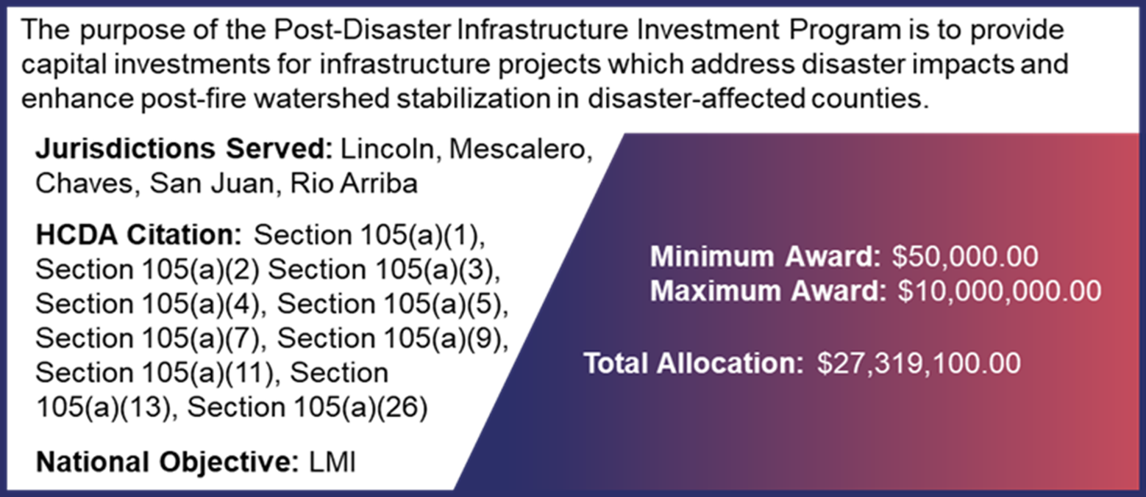
Post Disaster Infrastructure Investment (PDIIP)
New Mexico Department of Homeland Security & Emergency Management

Slide 7
Eligible Activities
Public Infrastructure Rehabilitation
Repair and restoration of damaged public infrastructure to restore essential services and support long-term community resilience.
Public Infrastructure Replacement or New Construction
Construction or full replacement of critical infrastructure elements where damage is severe or systems are outdated, with a focus on resilience and hazard mitigation.
Community Enhancement and Hazard Mitigation Infrastructure investments for facilities, projects, and other features that reduce future disaster risk, promote community resilience, and support recovery in underserved or vulnerable areas.
New Mexico Department of Homeland Security & Emergency Management

Slide 8
Notice of Funding Availability (NOFA)
June 15, 2026
September 13, 2026
NOFA will be released
DHSEM will notify eligible entities
NOFA will be posted to DHSEM’s CDBG-DR website at dhsem.nm.gov/cdbg-dr2025
Hard copies will be available through DHSEM State Applicant Liaisons
NOFA Closes
Proposals can be submitted on DHSEM’s CDBG-DR website at dhsem.nm.gov/cdbg-dr2025
or through DHSEM State Applicant Liaisons
New Mexico Department of Homeland Security & Emergency Management

Slide 9
Disbursement of Funds
The PDIIP will disburse funds to subgrantees the following ways:
Advance Payments
Advance payments for expected costs may be provided for the following expense types:
  Staff time and/or vendor support to conduct procurement(s) to execute the project.
  Studies, reviews, and other analyses necessary to validate project scope (e.g., H&H studies for drainage projects).
  Basic office set-up and staffing costs to stand up the project (e.g., PDIIP-specific staff payroll expenses, equipment).
Advances must be tied to immediate stand-up activities!
Progress-Based Drawdown Requests
Once the project has begun, all remaining grant funding will be processed through draw requests. DHSEM will provide a standard draw package which will require subgrantees tie funding to measurable project milestones for project planning, design, and implementation.
and
New Mexico Department of Homeland Security & Emergency Management

Slide 10
dhsem.nm.gov
Eligible Entities
Who can submit a project proposal for PDIIP funding?
The entity must be a unit of local government or recognized political subdivision (includes acequias) impacted by the federally declared disasters of 2024 (DR-4795-NM; DR-4843-NM)
Proposed projects must be located in one of these jurisdictions:
  Lincoln County
  Chaves County
  San Juan County
  Rio Arriba County
  Mescalero Apache Tribe
New Mexico Department of Homeland Security & Emergency Management

Slide 11
Eligible Activity Examples
  Road and Bridge Repair
  Drainage and Stormwater Improvements
  Utility System Restoration
  Acequia Restoration
  Public Facility Restoration
  Demolition and Clearance
  Code Enforcement
  Accessibility Improvements
  Flood and Fire Mitigation Measures
  Public Space Rehabilitation
  Non-Federal Cost Share
New Mexico Department of Homeland Security & Emergency Management

Slide 12

Ineligible Activities
Purchase of Equipment
(Unless essential to a public service or
necessary to complete project
(e.g., temporary generators during
construction)
IMPORTANT:
Project proposals cannot include any of these activities!
Buildings for the General Conduct of Government
General Government Expenses
Operating and Maintenance Costs
Political Activities and Lobbying
Direct Income Payments
New Mexico Department of Homeland Security & Emergency Management

Slide 13
Eligible Project Proposals
  Disaster Impact: Must propose a project which addresses post-disaster conditions and be located in a HUD-identified or State-identified Most Impacted or Distressed (MID) area
  Local Government or Political Subdivision: Must be a unit of local government or recognized political subdivision (including acequias).
  Low- and Moderate Income (LMI) Area Benefit (LMA): Must propose a project which demonstrates LMI area benefit (i.e., at least 51% or more beneficiaries meet LMI thresholds).
  Cost Reasonableness: Must utilize a reasonable cost method for determining overall project cost.
New Mexico Department of Homeland Security & Emergency Management

Slide 14
Disaster Tieback
Entities must provide a tieback justification supported by adequate documentation demonstrating that the proposed activity:
  Repairs, replaces, or restores infrastructure damaged by the disaster (direct tieback);
  Addresses conditions caused or exacerbated by the disaster, including system failures, loss of service, or increased risk (indirect tieback); or
  Implements mitigation measures designed to reduce the risk of future damage or disruption from hazards of the type experienced during DR-4795 or DR-4843, where such risks or vulnerabilities are identified through post disaster assessments, hazard data, or the unmet needs analysis.
All projects must demonstrate a clear and documented tieback to DR-4795 or DR-4843.
Projects can demonstrate disaster tieback by addressing a disaster-related impact, unmet recovery need, or documented vulnerability identified in the State’s CDBG-DR Action Plan or unmet needs assessment.
New Mexico Department of Homeland Security & Emergency Management

Slide 15
Project Proposal Submission
Eligible Entities must submit their project proposals by
Sunday September 13, 2026 at 11 p.m. MDT
Option 1
Option 2
Option 3
Submit online:
DHSEM’s CDBG-DR website
dhsem.nm.gov/cdbg-dr2025 or email to PDIIP@dhsem.nm.gov
Submit in person:
Provide a complete project proposal packet to a DHSEM State Applicant Liaison (SAL)
Submit in by mail:
Department of Homeland Security and Emergency Management
Attention: Post Disaster Infrastructure Investment Program
PO Box 27111
Santa Fe, NM 87502
New Mexico Department of Homeland Security & Emergency Management

Slide 16
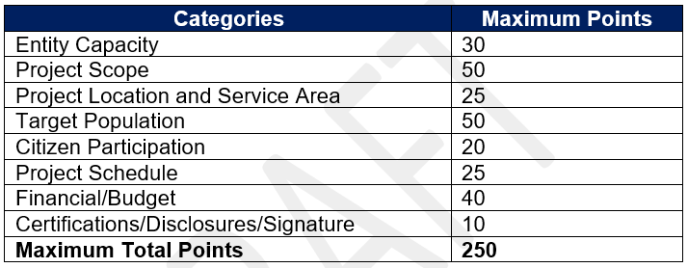
Proposal Scoring Rubric
Project proposals will be evaluated and scored
New Mexico Department of Homeland Security & Emergency Management

Slide 17
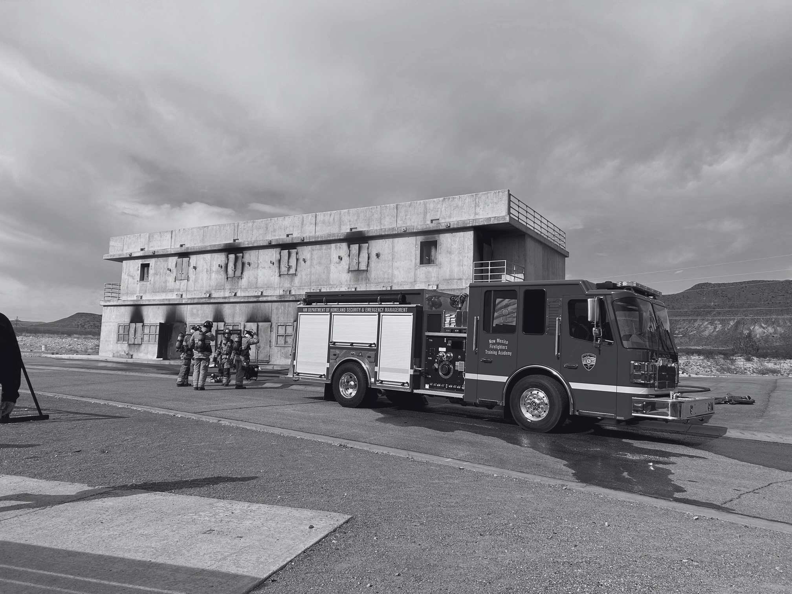
Prioritization Criteria
Projects that meet any of the following criteria will be prioritized during proposal scoring:
  Projects in Lincoln and Chaves Counties
    HUD-designated Most Impacted and Distressed (MID) Areas
    DHSEM has a set target of spending at least 50% of PDIIP funds on projects in these counties.
  Projects that support rural and agricultural communities
  Projects that accomplish hazard mitigation in the impacted area.
New Mexico Department of Homeland Security & Emergency Management

Slide 18
Project Proposal Overview
  Entity Information
  Entity Capacity
  Project Scope
  Project Location and Service Area
  Target Population
  Citizen Participation
  Project Schedule
  Financial/Budget
  Local Certifications
  Conflict of Interest Disclosure
  Proposal Acknowledgement and Signature
A complete project proposal must provide the following:
New Mexico Department of Homeland Security & Emergency Management

Slide 19
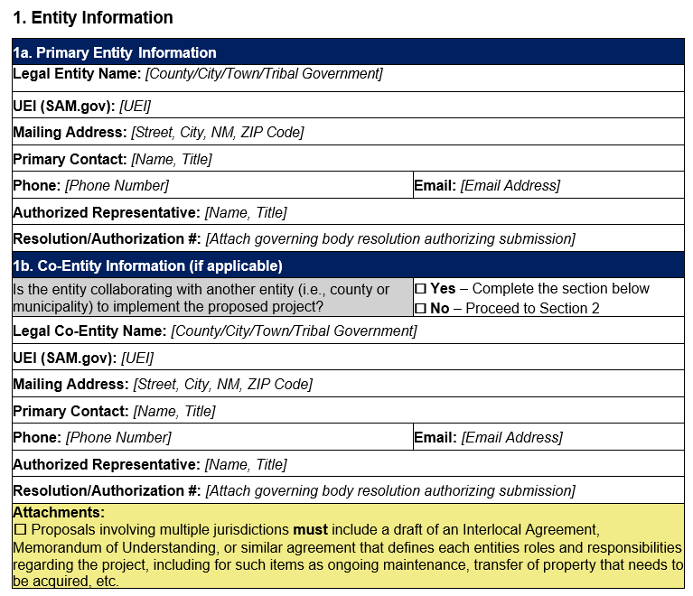
Entity Information
Reminder:
In Section 1 of your proposal please remember to attach resolutions and any MOUs (if applicable).
New Mexico Department of Homeland Security & Emergency Management

Slide 20
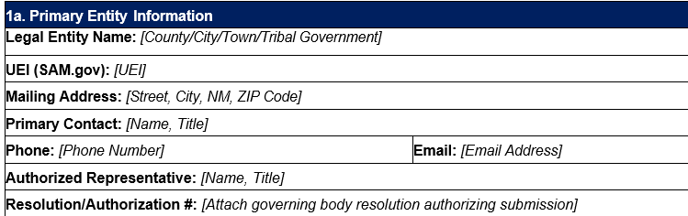

Unique Entity Identifier (UEI)
All entities must have a UEI
New Mexico Department of Homeland Security & Emergency Management

Slide 21

Entity Capacity
Strong Proposals:
  Clearly demonstrate the ability to manage the project.
  Staff and consultants are named.
  Written financial and/or operational procedures are included.
  Entity provides documented examples of successful project management similar in size, scope, or funding type.
New Mexico Department of Homeland Security & Emergency Management

Slide 22

Project Scope
Strong Proposals:
  The project is clearly defined, eligible, and feasible.
  The project provides:
    a detailed scope,
    clearly ties the project to the disaster,
    cites eligibile activities, and
    demonstrates site-specific, documented mitigation measures designed to reduce long-term risk, along with operations or maintenance considerations.
New Mexico Department of Homeland Security & Emergency Management

Slide 23

Project Location & Service Area
Strong Proposals:
  Provide a clear and thorough analysis of the project location and service area.
  Maps, photos, unmet needs, alternatives, and impacts are clearly documented.
*Guidance for properly defining your project’s service area can be found in Section 3.6.2 of the PDIIP Guide and Appendix A of the Proposal Template.
New Mexico Department of Homeland Security & Emergency Management

Slide 24

Target Population: Rural and Agricultural Communities
Strong Proposals:
  Are located in a rural area as defined by the USDA Community Facilities Direct Loan & Grant Program.
  Explain how the project benefits rural and agricultural communities.
  Have a description that is:
    Specific,
    Well supported,
    And demonstrates meaningful infrastructure improvement.
USDA Community Facilities Direct Loan & Grant Program Rural Definition:
Rural areas, including cities, villages, townships, and towns including Federally Recognized Tribal Lands with no more than 20,000 residents according to the latest U.S. Census Data.
New Mexico Department of Homeland Security & Emergency Management

Slide 25

Target Population: Low- and Moderate-Income (LMI) Communities
Benefit to LMI Communities will be evaluated based on whether the Project meets HUD’s LMI Area (LMA) Benefit National Objective.
What is LMA Benefit?
To qualify under the LMA national objective, a project must:
  Be located in, or provide services to, an area where at least 51% of residents are low- and moderate-income (LMI); and
  Provide services or access that are broadly available to all residents within the service area, without exclusion.
Strong Proposals:
  Clearly demonstrate LMI Area Benefit.
  Have a well-defined service area.
  Data and maps align with narrative.
  Clearly explain how the project benefits Low- and Moderate-Income residents.
New Mexico Department of Homeland Security & Emergency Management

Slide 26
Low- and Moderate-Income Summary Data (LMISD)
What is LMISD?
  A specialized, census-based dataset published by the U.S. Department of Housing and Urban Development (HUD).
  It calculates the percentage of LMI residents within specific geographical areas, such as census block groups, tracts, and municipalities.
Which projects must use LMISD?
  All projects must calculate LMISD.
  If your project can’t prove LMI Area Benefit using LMISD, you will need to conduct CDBG-DR Income Surveys with every household in your project’s service area.
How do I calculate LMISD for my project’s service area?
Instructions for LMI Summary Data calculation can be found in Appendix A - Mapping Project Service Area / Low- and Moderate-Income Summary Data (LMISD) Calculation.
New Mexico Department of Homeland Security & Emergency Management

Slide 27
CDBG-DR Income Surveys
How do I complete CDBG-DR Income Surveys for my project?
If your project’s service area’s LMI percentage using LMISD data is less than 51%, you must contact the Post-Disaster Infrastructure Investment Program to create a CDBG-DR Income Survey specific to your project service area and receive technical assistance on using that data to calculate the project service area’s LMI percentage.
What is a CDBG-DR Income Survey?
  A tool from HUD that can be used to prove LMA Benefit
  Must complete survey with every household in the project’s service area
Which projects must complete CDBG-DR Income Surveys?
Projects that can’t prove LMA Benefit with LMI Summary Data must prove LMA Benefit with CDBG-DR Income Surveys.
New Mexico Department of Homeland Security & Emergency Management

Slide 28

Citizen Participation
Strong Proposals:
  Provide a Citizen Participation Plan that exceeds minimum requirements.
  Have a plan considers the specific needs of the communities being served by the project.
  Attach all relevant files demonstrating that operations were done pursuant to your plan.
  Either provide written citizen complaint procedures or check in the project proposal that your entity is adopting the State’s complaint procedures.
New Mexico Department of Homeland Security & Emergency Management

Slide 29
Citizen Participation Plan Requirements
All proposals for the PDIIP must include a Citizen Participation Plan.
Three options to provide Citizen Participation Plan:
  Use the template provided by DHSEM (Appendix C) to create a plan
  Submit existing plan adopted by the entity’s jurisdictional or organizational authority
  Develop a plan without using the template in Appendix C
Citizen Participation Plans must include:
  How the entity will encourage participation from residents, including low- and moderate-income (LMI) households, non-English speakers, and individuals with disabilities.
  30 day public comment period
  At least 2 public hearings
  Citizen Complaint Procedures
    DHSEM’s Citizen Complaint Procedures can be adopted by the eligible entity
New Mexico Department of Homeland Security & Emergency Management

Slide 30

Citizen Participation Plan Documentation
Supporting documentation demonstrating a public comment period and public hearings must be submitted to DHSEM within 60 days of receiving a Notice of Intent to Fund.
Examples of supporting documentation include:
  Notices of public hearings or public comment period
  Sign in sheets from public hearings
  Proof of publication of notices in a local newspaper
What you provide as documentation must align with the requirements in your Citizen Participation Plan!
New Mexico Department of Homeland Security & Emergency Management

Slide 31

Project Schedule
Strong Proposals:
This is an all-or-nothing score. If any of the following are missing or incomplete, the score will be zero. The project schedule must:
  Demonstrate the ability to begin and end the project within program deadlines.
  Outline key milestones, such as, but not limited to, planning and studies, environmental review, acquisition/relocation, project design (plans, A&E), obtaining permits, and project closeout.
  Complete each section of 7. Project Schedule as applicable.
Tips for creating your project schedule:
Add in time for delays.
Account for coordinating with DHSEM on the Environmental Review.
Add time for permitting.
Be sure to have everything needed for a strong close out.
New Mexico Department of Homeland Security & Emergency Management

Slide 32

Financial/Budget
Strong Proposals:
  The budget is complete and well supported.
  Detailed cost estimates, committed funding sources, coordination with other funding streams, considerations of duplication of benefits, and the procurement approach are clearly documented.
Tips for creating your project budget:
Be sure to convey all funding sources.
Prepare your cost reasonableness and procurement procedures.
Consider Duplication of Benefits (DOB).
New Mexico Department of Homeland Security & Emergency Management

Slide 33

Certifications, Disclosures, and Signatures
Strong Proposals:
This is an all-or-nothing score. If any required certification, disclosure, or signature is missing or incomplete, the score will be zero.
Full Points = All required certifications, disclosures, and signatures are complete and properly executed.
Zero Points = One or more required certifications, disclosures, or signatures are missing or incomplete.
Local certifications
  Proposals must include a signed and complete SF-424 form
  Remember to review the certifications in the proposal packet.
New Mexico Department of Homeland Security & Emergency Management

Slide 34

Local Certifications: Federal Labor Requirements
Selected projects MUST comply with federal labor requirements, including but not limited to:
  Davis Bacon and Related Acts (DBRA)
  Section 3 of the Housing and Urban Development Act of 1968 (Section 3)
New Mexico Department of Homeland Security & Emergency Management

Slide 35
Eligible Activity Citations
The following sections of the Housing and Community Development Act of 1974 (HCDA) provides the statutory basis for eligible program activities:
  Section 105(a)(1): Acquisition of Real Property
  Section 105(a)(2): Public Facilities and Improvements
  Section 105(a)(3): Code Enforcement
  Section 105(a)(4): Clearance, Demolition, Removal, Reconstruction, and Rehabilitation
  Section 105(a)(5): Architectural Barrier Removal
  Section 105(a)(7): Disposition of Real Property
  Section 105(a)(9): Payment of Non-Federal Share
  Section 105(a)(11): Relocation Payments and Assistance for Displaced Individuals, Families, Businesses, Organizations, and Farm Operations
  Section 105(a)(13): Payment of Reasonable Administrative Costs
  Section 105(a)(26): Lead-Based Paint Hazard Evaluation and Reduction
New Mexico Department of Homeland Security & Emergency Management

Slide 36
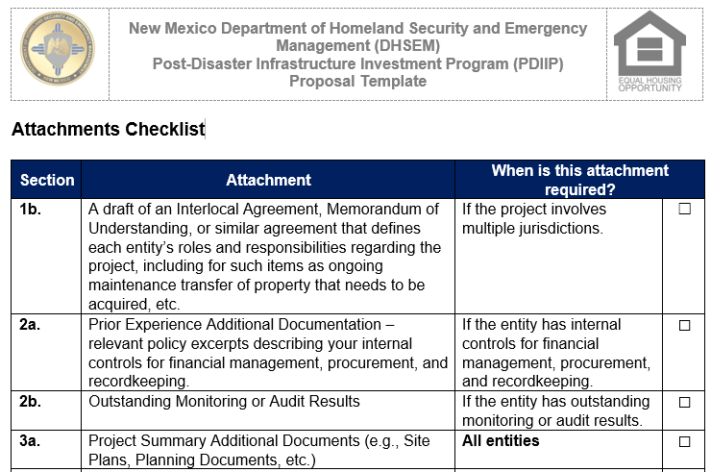
Supporting Documentation
Supporting documentation required will vary by project type and proposal. See the Attachments Checklist on pages 23-25 of the proposal template for a list of all attachments, which proposal section they correlate to, and when the attachment is required.
Some attachments are required for all proposals, and some attachments are only required in certain circumstances.
New Mexico Department of Homeland Security & Emergency Management

Slide 37
Proposal Template Appendices
Appendix D: Project Cost Estimate Instructions and Example
  Only required for entities whose projects involve construction-related work.
Appendix E: Duplication of Benefits Worksheet
  All entities must complete, even if they aren’t receiving any other funding for this project.
Appendix F: Instructions to Complete the Application for Federal Assistance Standard Form 424 (SF-424)
  All entities must complete SF-424. This appendix provides detailed instructions for completing this form.
Appendix G: Conflict of Interest Disclosure Form
  All entities must have their Authorized Contract Signer complete and sign this form.
Appendix A: Mapping Project Service Area/LMISD Calculation
  All entities must use this tool to map their project service area.
  If data in this tool shows that at least 51% of the project service area’s households are LMI, the entity has proved LMA Benefit and does not need to complete CDBG-DR Income Surveys with households in the service area.
Appendix B: CDBG-DR Income Survey Guidance
  Used to prove LMA Benefit if LMISD doesn’t qualify project. Entities that qualify with LMISD do not need to complete surveys with households in their project’s service area.
Appendix C: Citizen Participation Plan Template
  Entities can, but are not required to, use this template to create their Citizen Participation Plan.
New Mexico Department of Homeland Security & Emergency Management

Slide 38
dhsem.nm.gov
Technical Assistance
It is recommended eligible entities review the following documents on DHSEM’s CDBG-DR website to support proposals:
dhsem.nm.gov/cdbg-dr2025
CDBG-DR New Mexico Action Plan 2024 Disasters
Post-Disaster Infrastructure Investment Program Guide
Technical Assistance is available from DHSEM to eligible entities.
For questions and/or to request technical assistance, contact PDIIP@dhsem.nm.gov
New Mexico Department of Homeland Security & Emergency Management

Slide 39
dhsem.nm.gov
QUESTIONS?
New Mexico Department of Homeland Security & Emergency Management

